Slide 1
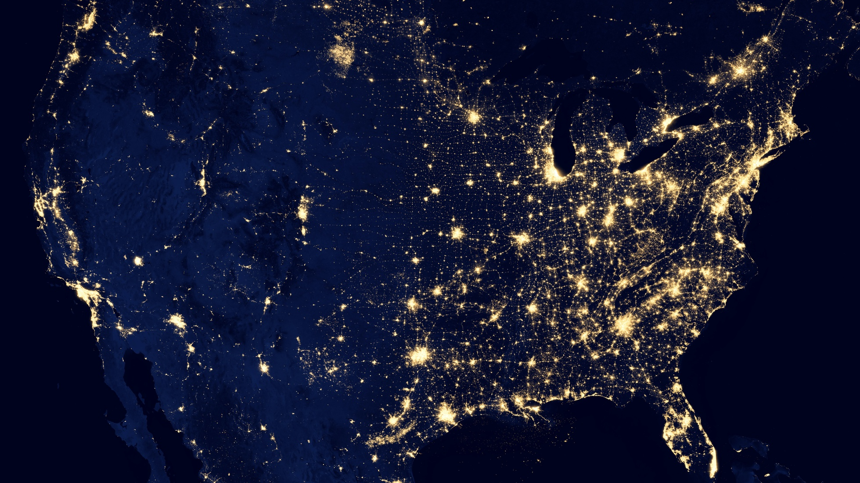

DIGIT RECOGNITION USING DEEP LEARNING
Neural Network Implementation
Sumaiya Islam | 10.09.2023
University of Dhaka, Kishan Kumar Ganguly

Slide 2
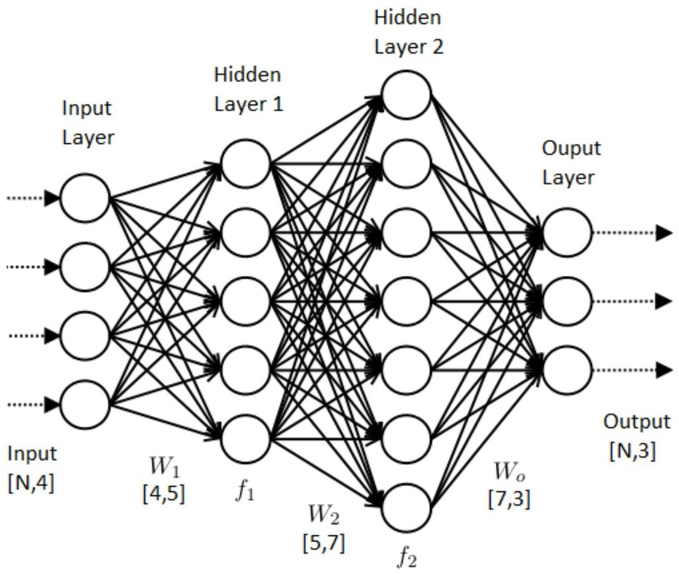
Neural Network Architecture
Training Data - MNIST Dataset
Forward Propagation
Backpropagation
Gradient Update
Training Step
Results

Slide 3
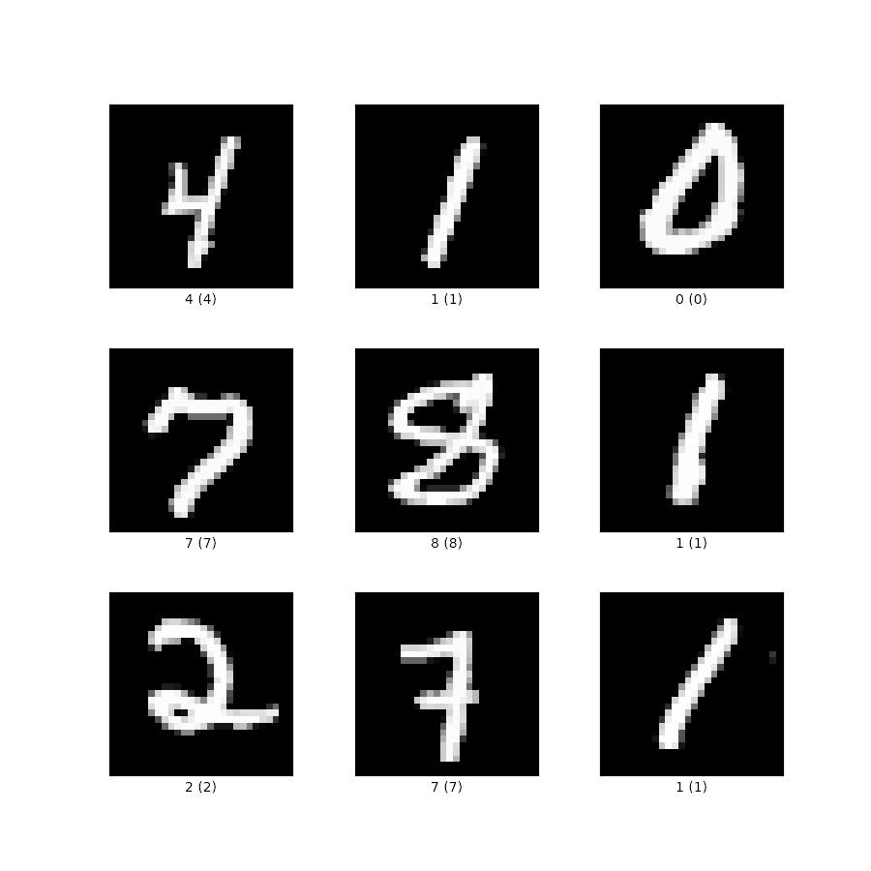
Training Data
MNIST Dataset
Collection of handwritten digits (0-9)
28x28 pixels
60,000 training images and labels
10,000 test images and labels

Slide 4

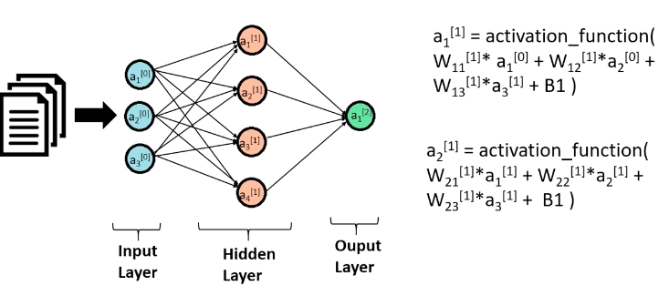
Forward Propagation.

Slide 5
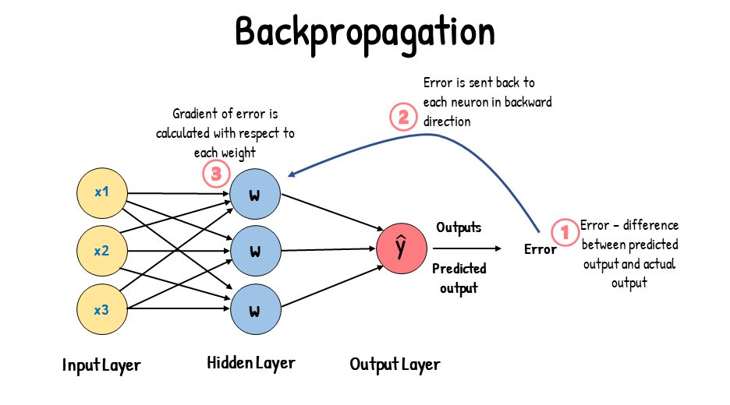

Slide 6

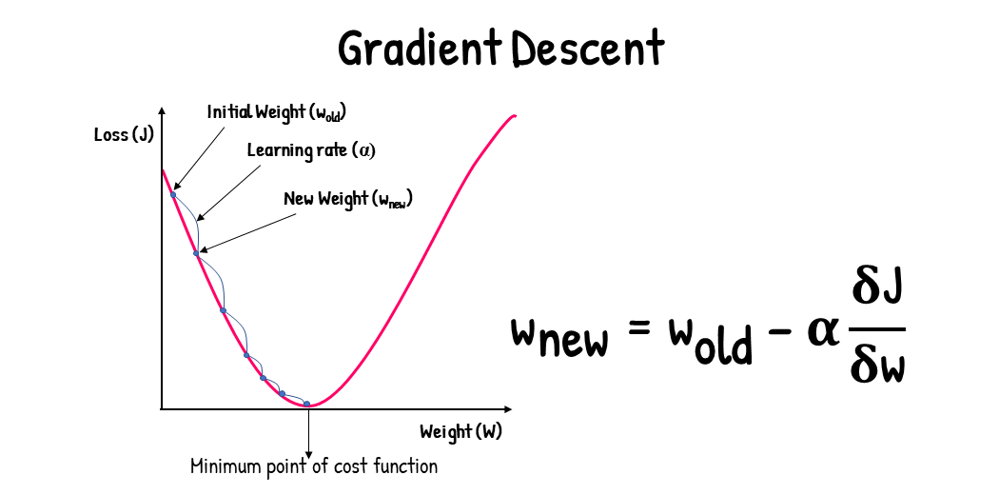
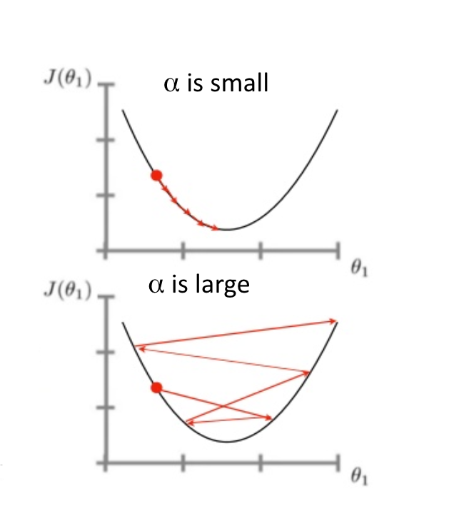
Gradient Descent

Slide 7
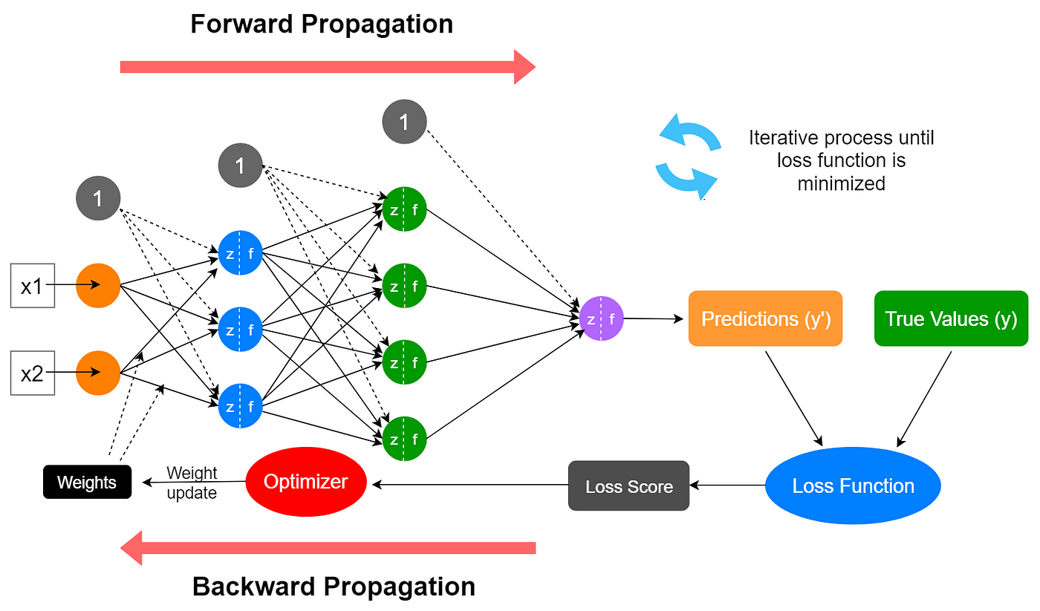

Slide 8
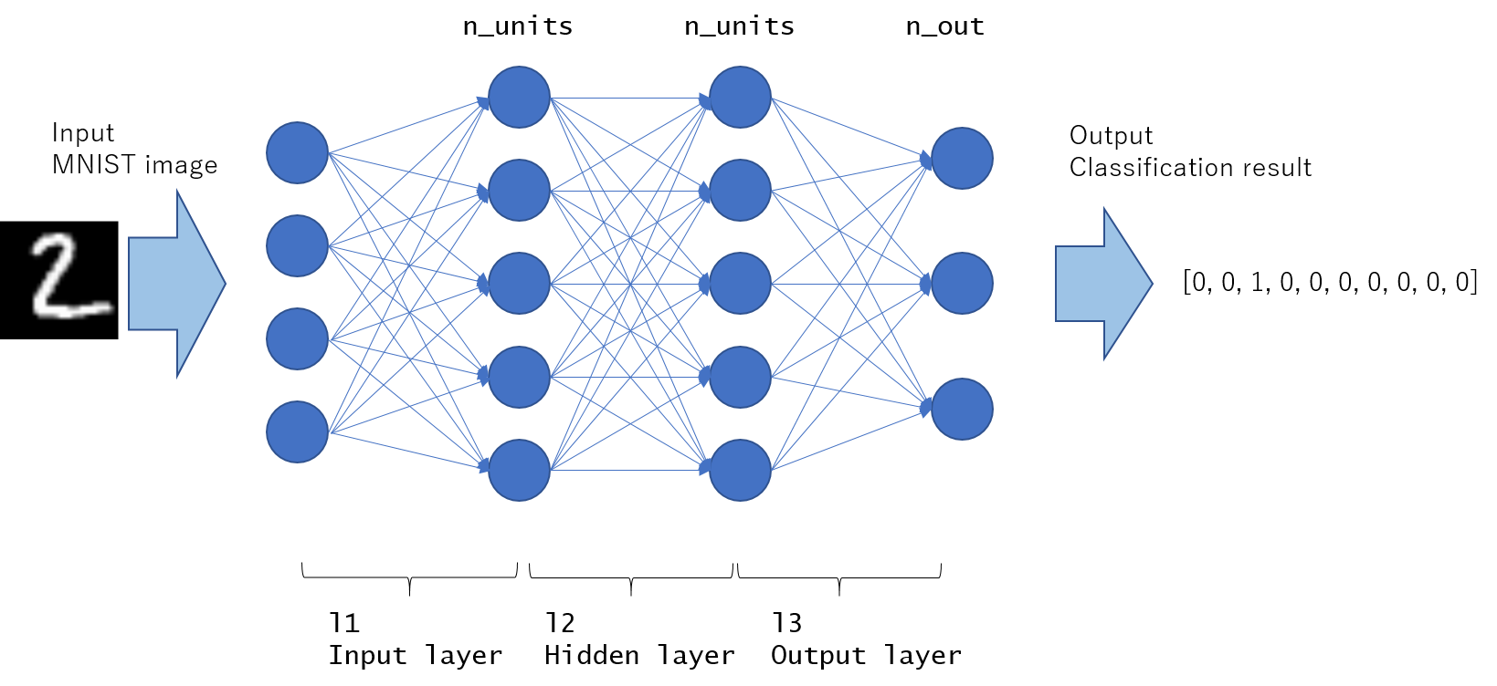

Results

Slide 9
Thank you.

